Slide 1
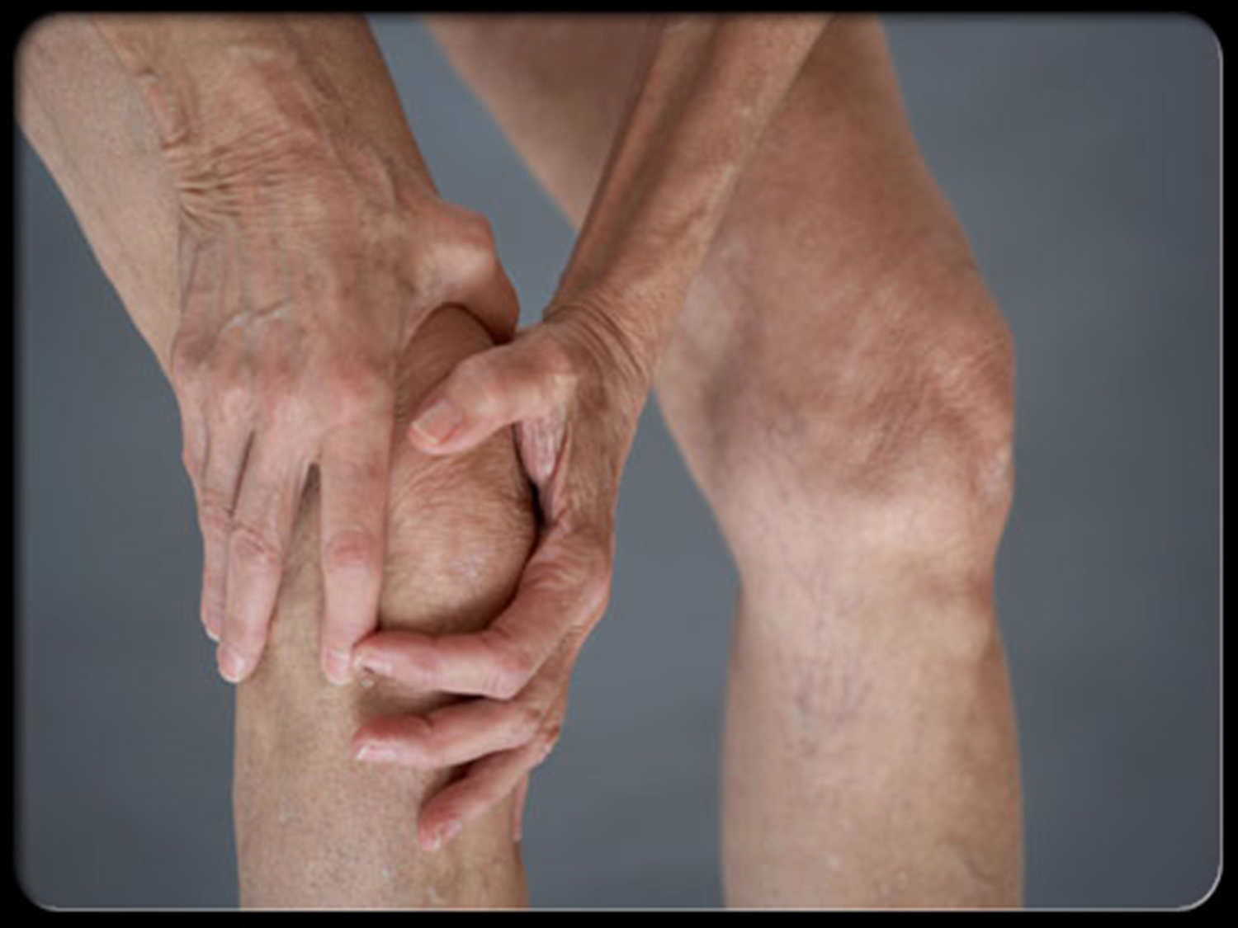
OSTEOARTHRITIS
Osteoarthritis
Dr. Husham Aldaoseri
30/Oct./2023

Slide 2
Osteoarthritis
Definition.
Classification.
Risk factors.
Patho- physiology.
Symptoms and signs.
Diagnosis.
Treatment

Slide 3
Definition
Osteoarthritis is a degenerative disease of synovial joints characterized by focal loss of articular hyaline cartilage with proliferation of new bone & remodeling of joint contour.

Slide 4
EPEpidemiologyDEeeEMIOLOGY
Weight bearing joints e.g. knee & hip joints.
Age > 65 years.
  80% have radiographic features.
  25-30% have symptoms.
More common in women.
Familial tendency.

Slide 5
ETIOLOGY
PRIMARY / IDIOPATHIC:
When there is no obvious predisposing factor. Common form of OA.
SECONDARY:
When degenerative joint changes occur in response to a recognizable local or systemic factor.

Slide 6
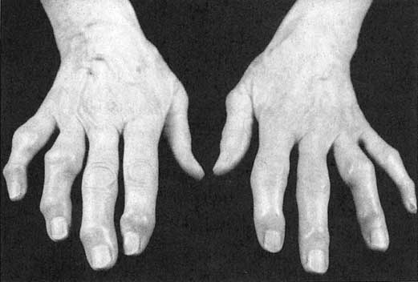
Primary OA
Localised Heberden s & Bouchard s nodes
Primary generlised OA.( involvement of 3 or more joints).

Slide 7
CAUSES OF SECONDARY OSTEOARTHRITIS
DEVELOPMENTAL
*HIP DYSPLASIA
ENDOCRINE
*ACROMEGALY
TRAUMATIC
*INTRA-ARTICULAR FRACTURE
*OCCUPATIONAL
*MENISECTOMY
INFLAMMATION
*RA
*GOUT
*SEPTIC ARTHRITIS
METABOLIC
*ALKAPTONURIA
*WILSON’S DISEASE
ASEPTIC NECROSIS
*CORTICOSTERIOD USE
*SLE
SICKLE CELL DISEASE
NEUROPATHIES
*SYRINGOMYELIA
*DIABETES MELLITUS
MISCELLANOUS
*PAGET’S DISEASE
*GAUCHER’S DISEASE

Slide 8
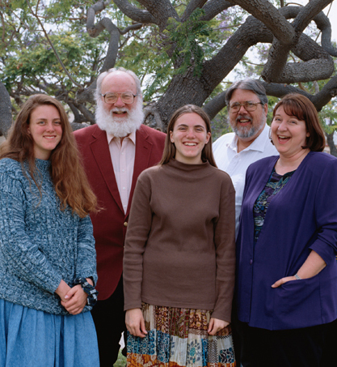
Risk factors you cannot change
Family history of disease
Increasing Age
female

Slide 9
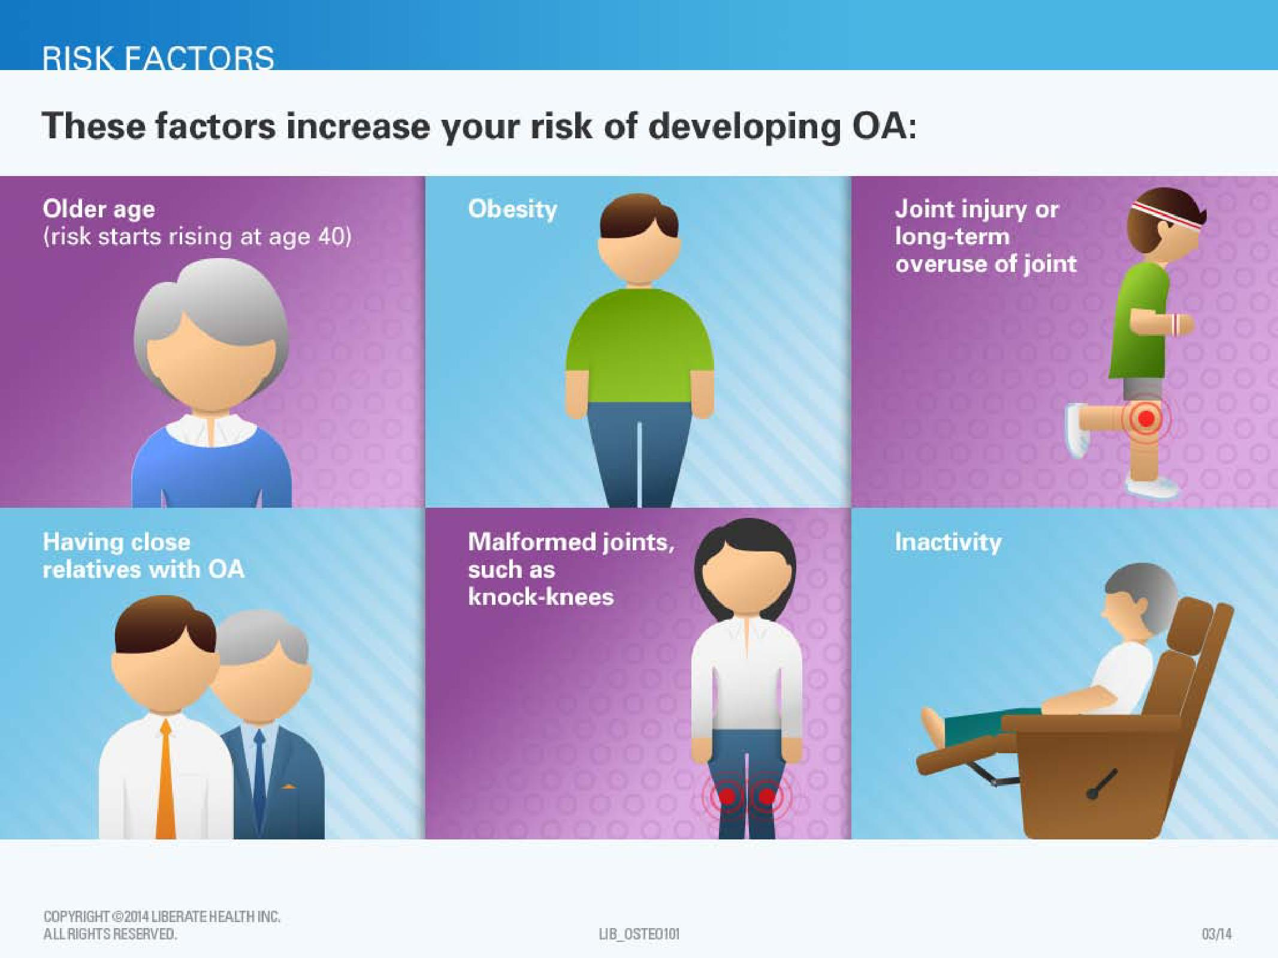
Risk factors you can change
Overuse of the joint
Major injury
Overweight
Muscle weakness
Notes:
Other risk factors for osteoarthritis can be changed.
In many cases you can lower your risk for developing osteoarthritis by avoiding or making improvements in these factors.
One risk factor that can be changed is overuse of the joint.
Constant, repetitive use of the joints can increase the chances of developing osteoarthritis.
For example, certain work environments can lead to an increased chance of having osteoarthritis. Construction workers have been found to have increased chances of developing osteoarthritis of the knee or the hip.
Also, repeated heavy lifting can lead to the development of osteoarthritis.
With awareness, you can change the way you do things to prevent overuse of your joints.

Slide 10
Pathogenesis & pathology
It is a disease of articular cartilage.
Chondrocytes are maintaining homeostasis of cartilage , it synthesize collagens, proteoglycans & proteinases.
OA results from failure of chondrocytes to synthesize a good quality of matrix in terms of elasticity & resistance & to maintain the balance between synthesis & degredation.
The degeneration process might be initiated by some stimuli ( Mechanical insult or Biochemical abnormalities of cartilage).

Slide 11
OA Disease Evolution – Stage I
Matrix
Degradation
⇓
Collagen
&
Proteoglycans
Chondrocyte
Proteases
⇑
Inhibitors
Notes:
Slide 6
Maintenance of normal joint homeostasis involves a balanced process of matrix degradation and repair performed predominantly by the resident chondrocytes. Chondrocytes respond to cytokines, growth factors, and physical stimuli in a complex manner in order to maintain joint integrity. This schematic illustrates that in OA this balance is disrupted, and matrix degradation, mediated by proteolytic enzymes that are no longer balanced by protease inhibitors, results in the release of matrix fragments in the synovial space.¹
¹Pelletier JP, Martel-Pelletier J, Howell DS. Etiopathogenesis of osteoarthritis. In: Koopman WJ, ed.
Arthritis and Allied Conditions: A Textbook of Rheumatology. Philadelphia, PA: Lippincott Williams & Wilkins;
2001;2:2195-2215.

Slide 12

OA Disease Evolution – Stage II
Synovial Fluid
Synovial
Membrane
Matrix
Breakdown
Products
Neoepitopes
Crystals
Collagen &
Proteoglycan
Fragments
Cartilage
Subchondral Bone
Notes:
Slide 7
In this arbitrary staging process, Stage II in the evolution of OA involves further fibrillation and erosion of the cartilage surface and the release of breakdown products into the synovial fluid. Synovial inflammation begins to play a more prominent role in the disease process and is secondarily related to multiple factors including microcrystals, mechanical stress, and matrix breakdown products, including neoepitopes resulting from collagenase activity. These matrix components are taken up by the macrophages in the synovial lining, thus promoting inflammation.¹
¹Pelletier JP, Martel-Pelletier J, Howell DS. Etiopathogenesis of osteoarthritis. In: Koopman WJ, ed. Arthritis and Allied Conditions: A Textbook of Rheumatology. Philadelphia, PA: Lippincott Williams & Wilkins; 2001;2:2195-2215.

Slide 13
OA Disease Evolution – Stage III
Synovial Fluid
Synovial
Membrane
Anabolism
Cytokines
Proteases
Nitric Oxide
⇓ Collagen
⇓ Aggrecan
Catabolism
Apoptosis
Necrosis
Cartilage
Subchondral Bone
Notes:
Slide 8
In the latter stage of the disease, Stage III, catabolism markedly outweighs the process of matrix repair (anabolism). In this stage, the phagocytosis of matrix degradation products by the synovial macrophages is related to a chronic inflammation of the synovium, which, in turn, results in the local synthesis of more proteases and pro-inflammatory cytokines. These proteases and cytokines released by synovial macrophages diffuse through the synovial fluid to the cartilage and induce additional matrix breakdown by direct macromolecular proteolysis. The cytokines stimulate the chondrocyte to synthesize more proteases. At this stage, the chondrocytes are hypersensitive to cytokine stimulation because of an increased expression of cell surface receptors. Cell apoptosis and necrosis are also seen. The process results in a vicious feedback cycle with matrix degradation leading to inflammation, which, in turn, stimulates further degradation. Throughout the process, biomechanical factors play an increasingly detrimental role.¹
¹Pelletier JP, Martel-Pelletier J, Howell DS. Etiopathogenesis of osteoarthritis. In: Koopman WJ, ed.
Arthritis and Allied Conditions: A Textbook of Rheumatology. Philadelphia, PA: Lippincott Williams & Wilkins;
2001;2:2195-2215.

Slide 14
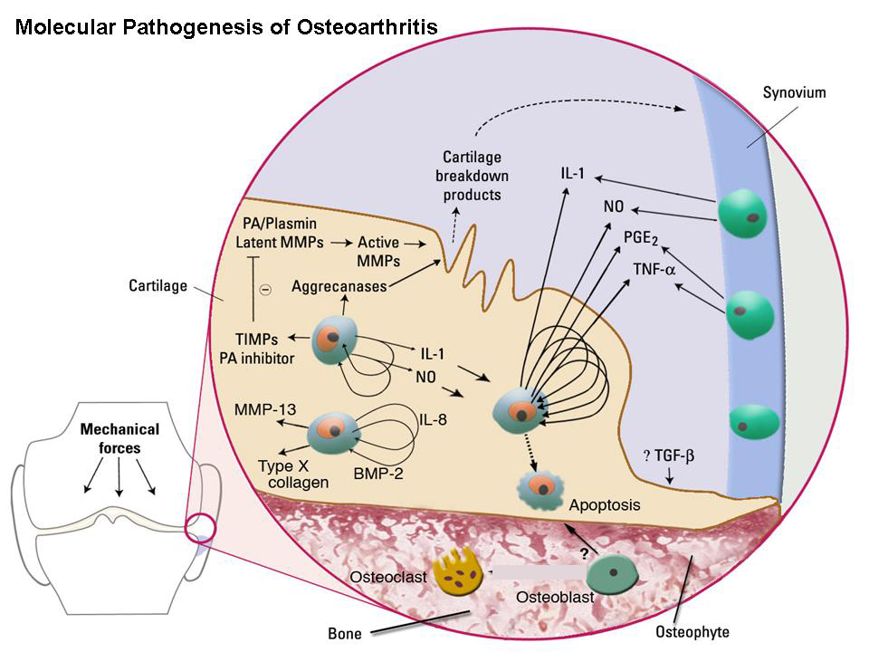

Slide 15
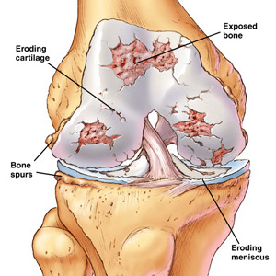

Slide 16
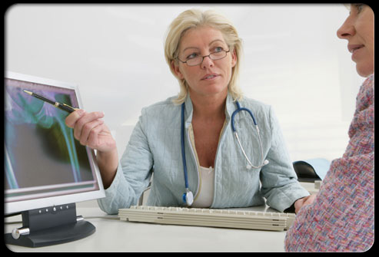
Clinical feature
Pain:
  Activity & weight-bearing related, relieved by rest.
  Variable over time.
  Only one or few joints involved.
stiffness only brief <15 minutes.
Restricted functionality
  Capsular thickening.
  Blocking by osteophytes.

Slide 17
Swelling, warmth, and creaking of the affected joints.
In severe OA, complete loss of the cartilage cushion causes friction between bones, causing pain at rest or pain with limited motion.
Progressive cartilage degeneration of the knee joints can lead to deformity and outward curvature of the knees, which is referred to as being bowleg.
 No constitutional or other extra-articular manifestations with primary OA

Slide 18
Most commonly seen in the hands (e.g., first carpometacarpal,
proximal interphalangeal [PIP], and distal interphalangeal [DIP]
joints) and weight-bearing joints (e.g., hips, knees, and spine)
Bouchard nodes represent bony enlargement of the PIP joints
Heberden nodes represent bony enlargement of the DIP joints

Slide 19
Hip
• Symptoms often localize to the groin and anterior thigh
• Distinguish from trochanteric bursitis (pain over the lateral aspect of the hip)
• Symptoms provoked by use (e.g., weight-bearing) and internal
rotation
Knee
• All three joint compartments may be affected (e.g., medial
tibiofemoral, lateral tibiofemoral, and patellofemoral)

Slide 20
Spine
• Characterized by pain, stiffness, and (sometimes) radicular symptoms
• Most commonly affects the lower cervical and lumbar spine.
Diffuse idiopathic skeletal hyperostosis (DISH)
• Variant of OA with axial and peripheral skeletal manifestations
• Radiographic diagnosis characterized by Flowing calcification or
ossification along the anterolateral aspect of at least four contiguous
vertebrae
• Relative preservation of the intervertebral disk space at the involved
levels (in contrast to classic OA)
• Absence of apophyseal or sacroiliac joint involvement (in contrast to
ankylosing spondylitis)

Slide 21
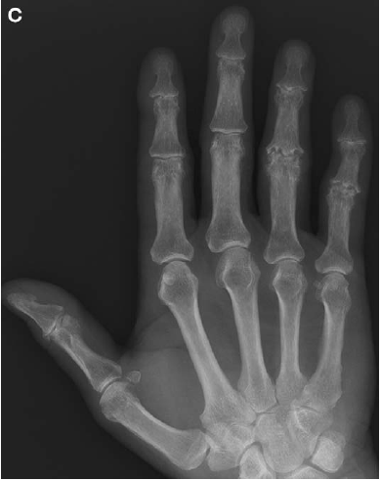
Erosive Osteoarthritis
 Affects the DIP and PIP joints
 Characterized by recurrent flares of pain, swelling and tenderness
Joint destruction occurs, leading to non uniform joint space loss and joint deformity
 May be associated with microcrystalline disease and can be confused with RA

Slide 22
Diagnosis
No blood test for the diagnosis of osteoarthritis
Blood tests are performed to exclude diseases that can cause secondary osteoarthritis.
X-rays: Loss of joint cartilage, narrowing of the joint space between adjacent bones, sclerosis of subchondral bone, subchondral bone cyst and bone spur formation.

Slide 23
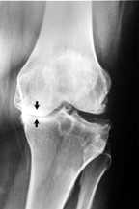
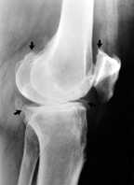
OA – Radiographic Diagnosis
Asymmetrical joint space narrowing
Sub-chondral sclerosis
Osteophytes
Sub-chondral bone cysts

Slide 24
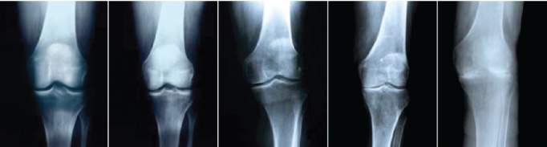
Kellgren-Lawrence Radiographic Criteria for Assessment
GRADE 0
GRADE 1
GRADE 2
GRADE 3
GRADE 4
Notes:
References:
1. Kellgren Lawrence 1957 - OA Radiology.pdf, p. 500, Figure 8

Slide 25
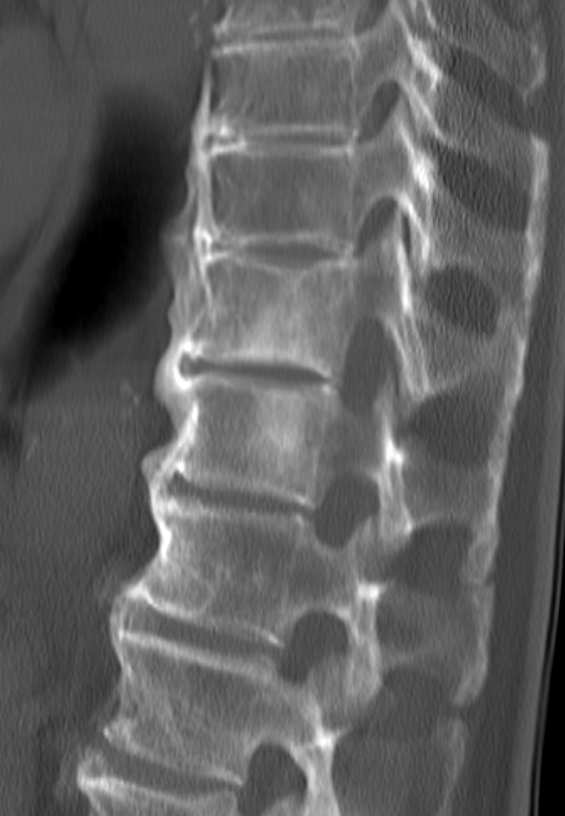
Radiographic findings in diffuse idiopathic skeletal hyperostosis (DISH), with flowing ossification along the anterolateral aspect of at least four contiguous vertebral bodies and relative preservation of the disk spaces.

Slide 26
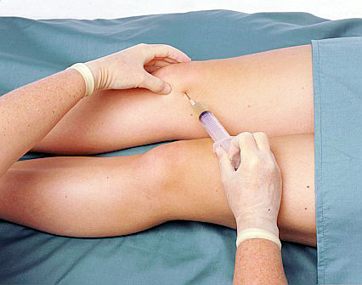
Arthrocentesis (Joint aspiration)
  Sterile needle is used to aspirate joint fluid for analysis.
  Joint fluid analysis is useful in excluding gout, infection, and other causes of arthritis.
Synovial fluid is noninflammatory with less than 2000 WBCs/mm3

Slide 27
Management of OA
The aims of treatment includes:
pain relief
Optimisation of function
Minimisation of disease progression.
There are three core interventions which should be considered for every person with osteoarthritis where possible:
• Education, advice and access to information
• Strengthening exercises to improve muscle strength and aerobic fitness training.
• Weight loss if overweight or obese

Slide 28
MANAGEMENT
NON-PHARMACOTHERAPY
PHARMACOTHERAPY
SURGICAL INTERVENTIONS

Slide 29
Management of OA
Non-pharmacologic
  Patient education
  Self-management programs
  Weight loss
  PT/OT
  ROM exercises
  Muscle strengthening
Non-pharmacologic
  Assistive devices
  Patellar taping
  Appropriate footwear
  Lateral-wedged insoles
  Bracing
  Joint protection and energy conservation

Slide 30
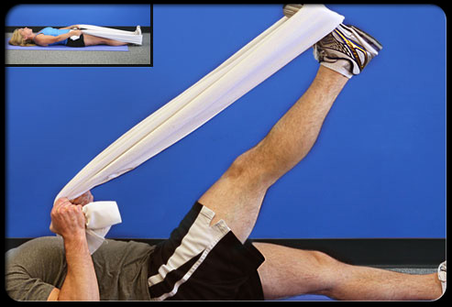
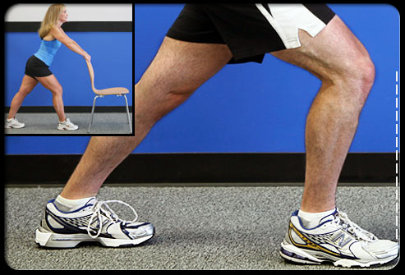
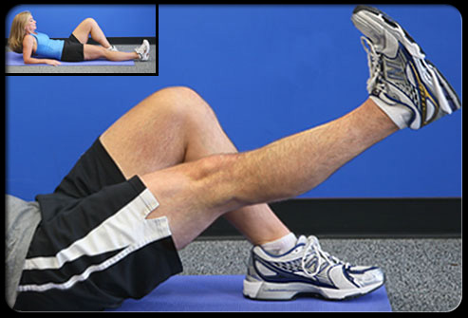
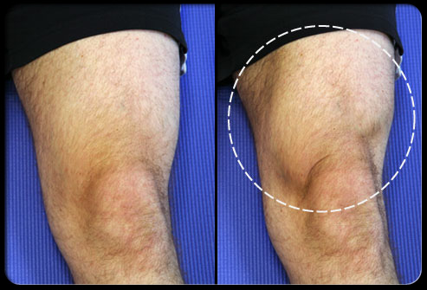

Slide 31
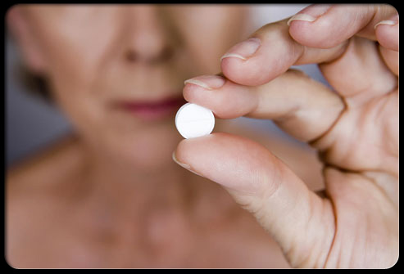
PHARMACOTHERAPY
PARACETAMOL
Initial drug of choice
Orally 1 gm 6-8 hourly
WEAK OPIOIDS
Occasionally required.
e.g: dihydrocodeine
NSAIDs
Indicated as needed.
Oral e.g: ibuprofen & coxibs
Topically e.g: capsaicin 0.025% cream
INTRA-ARTICULAR CORTICOSTEROIDS INJECTIONS
HYALURONIC INJECTIONS
Injections for 3-5 weeks.
Pain relief for several months.
Glucosamine and chondroitin sulfate may provide
symptomatic relief

Slide 32
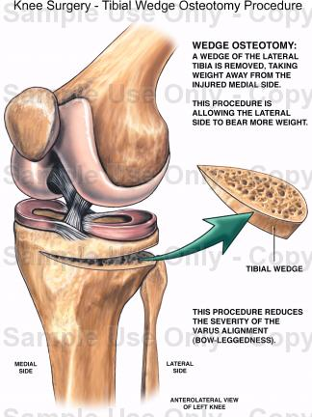
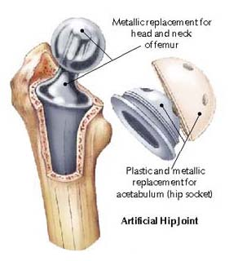
SURGICAL TREATMENT
Is indicated in patients with symptoms and functional impairment that are unresponsive to medical intervention
  Osteotomy.
  Partial Joint replacement.
  Total joint replacement.

